Slide 1
Seamless Appointment Booking For Health
SlideMake.com

Slide 2
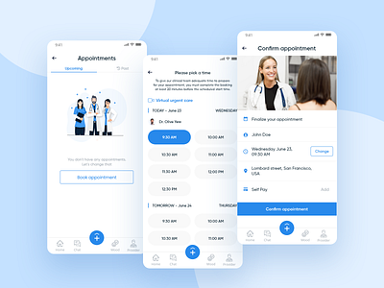
Introduction to Seamless Appointment Booking
Seamless appointment booking enhances patient experience by simplifying the scheduling process.
It reduces administrative workload for healthcare providers and minimizes errors.
Implementing this technology is essential for modern healthcare delivery and patient satisfaction.
Notes:
Image source: https://cdn.dribbble.com

Slide 3

Benefits for Patients
Patients can easily view available slots and select convenient times without phone calls.
Online booking offers flexibility, allowing appointments to be scheduled anytime, anywhere.
It improves access for diverse populations, including those with mobility or time constraints.
Notes:
Image source: https://www.slidemake.com

Slide 4
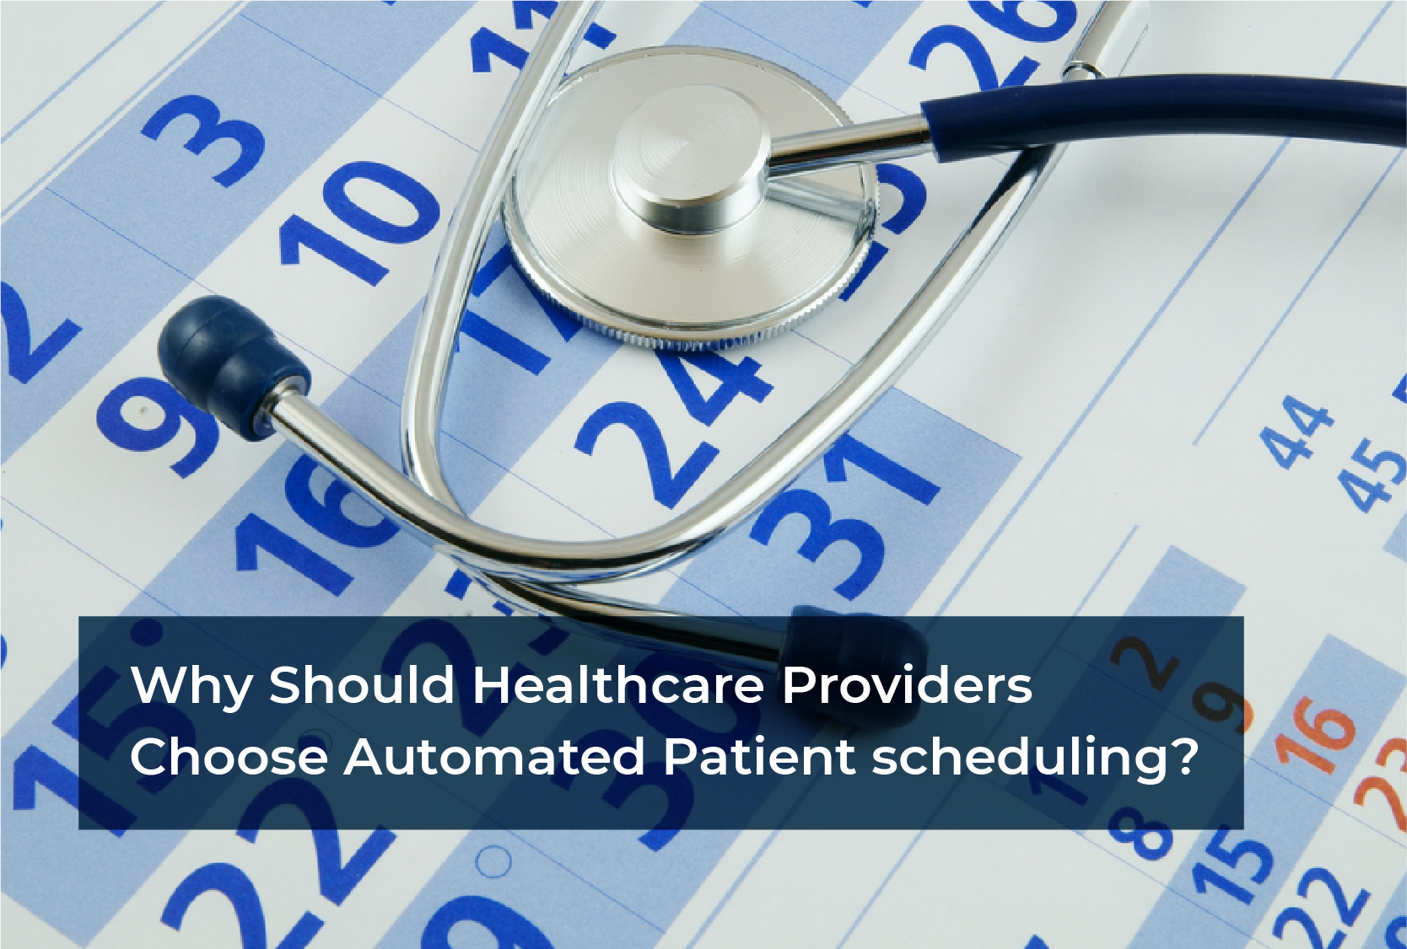
Benefits for Healthcare Providers
Automated appointment scheduling reduces administrative burdens and staff workload.
It minimizes no-shows through automated reminders and easy rescheduling options.
Providers gain better visibility into appointment flows, aiding in resource planning.
Notes:
Image source: https://automationedge.com

Slide 5
Key Features of a Seamless Booking System
User-friendly interfaces for quick and intuitive appointment scheduling.
Integration with electronic health records (EHR) for accurate patient data management.
Automated notifications and reminders to enhance appointment adherence.
Notes:
Image source: https://cdn.dribbble.com

Slide 6
Technology and Integration
Cloud-based platforms enable real-time updates and scalability.
Compatibility with existing healthcare IT systems ensures a smooth implementation.
Secure data encryption protects patient information and complies with privacy regulations.
Notes:
Image source: https://www.slidemake.com

Slide 7
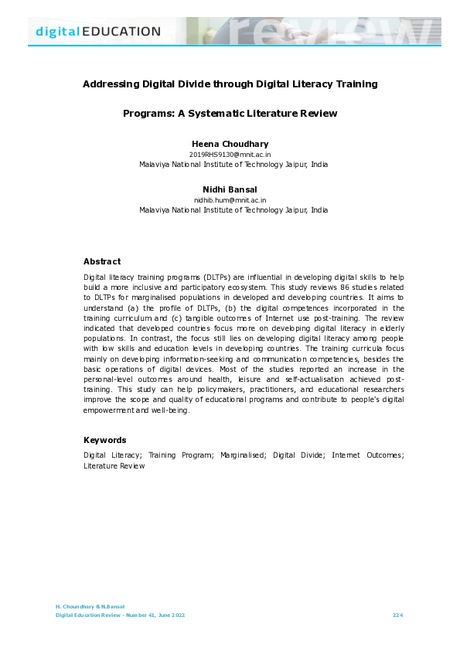
Challenges and Solutions
Addressing digital divide issues requires offering multiple booking channels.
Ensuring data security and privacy remains a top priority.
Continuous system updates and staff training are essential for optimal functionality.
Notes:
Image source: https://0.academia-photos.com

Slide 8
Future Trends in Appointment Booking
AI-powered chatbots can assist patients in booking and answering queries.
Mobile health apps will play a larger role in appointment management.
Integration with telehealth services will streamline virtual and in-person visits.
Notes:
Image source: https://www.slidemake.com

Slide 9
Conclusion and Call to Action
Seamless appointment booking is vital for efficient, patient-centered healthcare.
Healthcare organizations should invest in user-centric, secure booking solutions.
Embracing technology will lead to improved health outcomes and higher patient satisfaction.
Notes:
Image source: https://cdn.dribbble.com

